Slide 1

Exploring the 4x4 Multiplier In Electronics
Join us on a journey to explore the fascinating world of 4x4 multipliers in electronics. From operational principles to design considerations, we'll cover everything you need to know.

Slide 2


What is a 4x4 Multiplier?
Principles
Applications
A 4x4 multiplier is an electronic circuit that multiplies two 4-bit binary numbers together, resulting in a 8-bit binary product.
The 4x4 multiplier is widely used in digital signal processing, electronic circuits, and computer processors to perform high-speed multiplication of binary numbers.

Slide 3

Operational Principles of a 4x4 Multiplier
1
AND Gates
The 4x4 multiplier is designed with sixteen AND gates that are connected to four input lines. The output from each gate is either high or low, depending on the input values.
2
Partial Products
The outputs from the AND gates are combined into eight partial products that are added to generate the final product.
3
Carry Propagation
To ensure accurate results, carry propagation is required to handle overflow from addition.

Slide 4

Advantages of Using a 4x4 Multiplier
Speed
4x4 multipliers offer high-speed multiplication and are ideal for use in real-time systems where quick decision-making is required.
Compactness
Integrated circuits can be designed using a 4x4 multiplier, making it a compact and space-saving option for complex circuits.
Cost-Effective
As 4x4 multipliers are widely used in electronic systems, creating one from scratch is not always necessary, making it a cost-effective option.

Slide 5
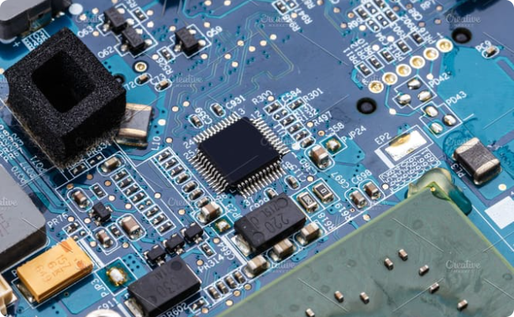
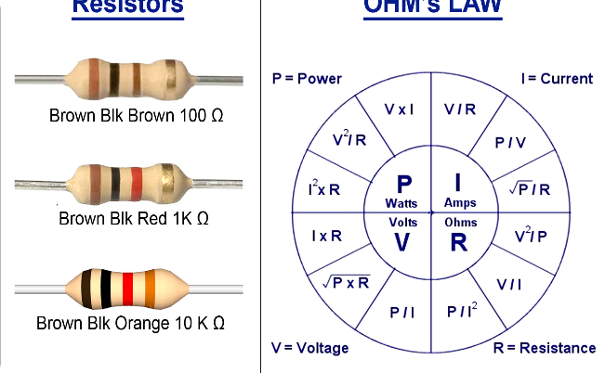
Design Considerations for a 4x4 Multiplier
Power Supply
Resistors
A stable power supply is critical to ensure correct operation of a 4x4 multiplier. Any fluctuations in power can result in discrepancies in the output results.
The resistors used in the circuit should have a high degree of linearity to minimize errors in output results.

Slide 6

Implementing a 4x4 Multiplier in a Circuit
1
Step 1: Design Schematic
The first step is to design the schematic of the 4x4 multiplier circuit, which includes the AND gates, op-amps, and resistors.
2
Step 2: PCB Design
The schematic is then translated to a printed circuit board (PCB) design, which is used to create the actual circuit.
3
Step 3: Testing
The final step involves testing the circuit to ensure that it is functioning correctly and that the output values are accurate.

Slide 7

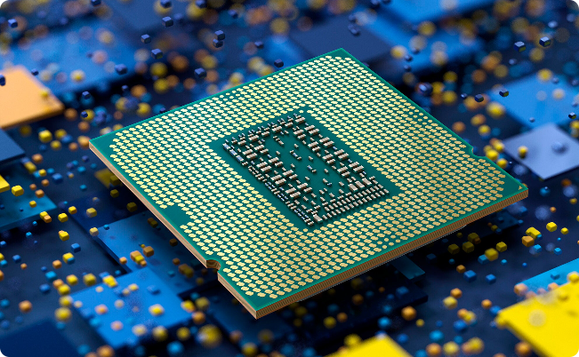
Applications of 4x4 Multiplier in Electronics
Digital Signal Processing
Computer Processors
The 4x4 multiplier is an essential component in digital signal processing systems, where high-speed multiplication is required for applications such as image and audio processing.
The 4x4 multiplier is a fundamental building block of modern-day computer processors, and it is used in arithmetic logic units (ALUs) to perform multiplication of binary numbers.

Slide 8
Conclusion and Final Remarks
In conclusion, the 4x4 multiplier is a key component of many digital systems, and its advantages include speed, compactness, and cost-effectiveness. However, careful design considerations are needed to ensure that the circuit is operating accurately and efficiently.

